Slide 1
Torque Transfer - Final Presentation
Shashank Hegde
Tushar Kumar
Sriram Ramaswamy
Sumeet Bachani

Slide 2
Apply Transfer Learning along with Reinforcement Learning
Using knowledge gained in one self driving environment, we train the same agent on a similar environment.
Compare the learning curves for agent with transfer learning and that without.

Slide 3
Background / Overview
Simulators
TORCS - FOSS Racing Car Sim
Donkey Car - FOSS DIY Car Sim
Training Algorithms
PPO - Off Policy, Sample Inefficient, Simple
Double Deep Q Learning - 2 NNs, Avoids Overestimation, Off Policy

Slide 4
Prior Research
Numerous AI agents for TORCS (including RL), most use sensor input instead of image input
AI agents with Donkey Car also use RL, but also employ VAE (Variational Autoencoders)
OpenAI Gym wrappers exist for both TORCS and Donkey Car
Transfer Learning with RL is almost non-existent

Slide 5
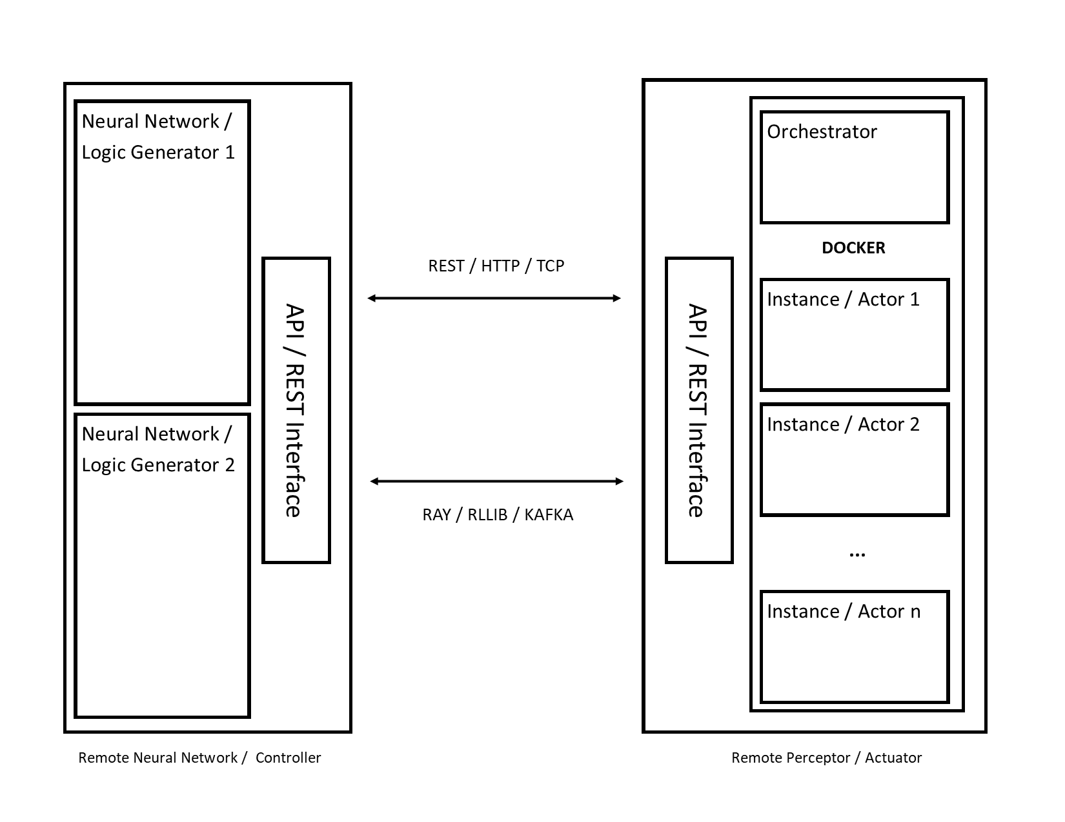
Custom Software
docker-torcs: https://github.com/Skeletrox/docker-torcs
Distributed RL system
Off-site learning and resource isolation
Generalizable for other projects
Automatic set-up

Slide 6
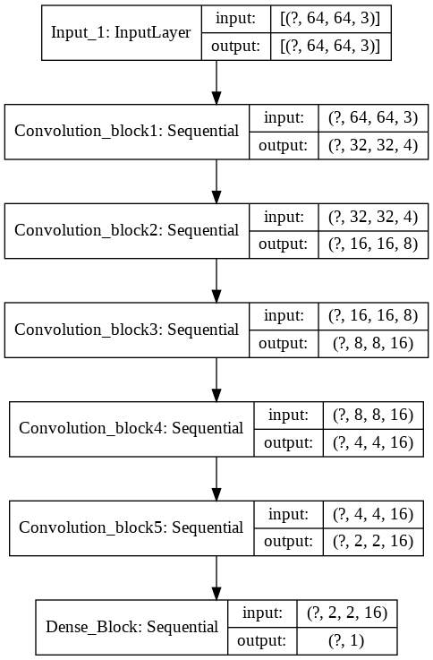
Model Structure
Each convolution block contains 2-3 convolution layers with max pooling.
The Dense block contains a flatten layer, 2 Dense layers of 512 units, 2 Dropout layers, and the final linear Dense layer.

Slide 7
Methodology
TORCS
Sensor Input: MLP as a policy network using PPO that uses sensor state from the input in order to generate actions (such as throttle and steering). Uses curriculum learning from simple tasks to more complex ones.
Image Input: Navigates using image result as input to a CNN, with only steering as the action. PPO is most effective but tends to prioritize “hacking” the reward by avoiding long steps and using shortcuts.
Imitation Learning: Interfaces sensor input to image input to avoid shortcuts and predict the driver action using a CNN. Error function is MSE, masters game after 50 epochs

Slide 8
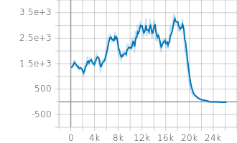
Training curves for TORCS using PPO, with image input
Look back!
Image forward is same as Image backward. This results in state space aliasing.
PPO critic only takes state as input, hence gets confused while predicting advantage. This causes fall in learning curve.
Therefore we used Imitation Learning.

Slide 9
Imitation Learning:
Simulate the first agent trained on sensor data.
Collect images and the corresponding steering angle action taken by the first agent.
Use supervised learning to fit steering angle to the given image using a Convolutional Neural Network
Simulate the trained model on the gym environment

Slide 10
Methodology
Donkey Car Sim:
To train the Donkey Car, same model was used as in TORCS but with DDQN as the RL algorithm.
One model was trained entirely from ground up with the model architecture as described before.
Another model was trained using a transfer learning based agent where the agent was pre-trained on TORCS.
The transfer learning was implemented by replacing just the final Dense layer and allowing all layers to be trainable.

Slide 11

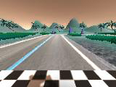
Image inputs
TORCS:
Donkey Car Simulator:

Slide 12
Tools
TORCS 1.3.7 with SCR-Server, patched by us to store images in a certain location instead of exposing a TCP port
gym-torcs, an OpenAI Gym wrapper over TORCS, patched by us to use REST endpoints in order to get data
Xvfb and xvfbwrapper, patched by us to use a fixed display number
PyTorch and Tensorflow
Tensorboard
OpenAI Gym
gym-donkeycar, an OpenAI Gym wrapper over Donkeycar
Google Colaboratory
Docker
Python, including libraries such as gym, flask, aiohttp
Donkey Car - April 2020 Update with Gym Donkey Car

Slide 13
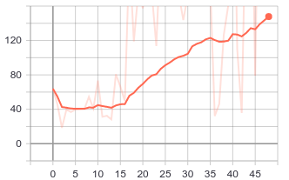
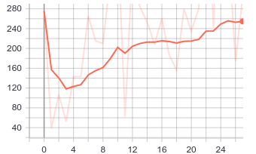
Results - Has a higher average reward
Model trained from Ground up
Model Trained using Transfer Learning
Reward Curve (Smoothened)

Slide 14
Results - Takes fewer episodes to train
Experiment Number | Ground Up Agent | Transfer Learning based Agent
1 | 67 | 34
2 | 45 | 53
3 | 42 | 30
4 | 46 | 45
5 | 36 | 58
Average Episode Length | 59 | 55
Average Number of Episodes taken to complete a lap

Slide 15
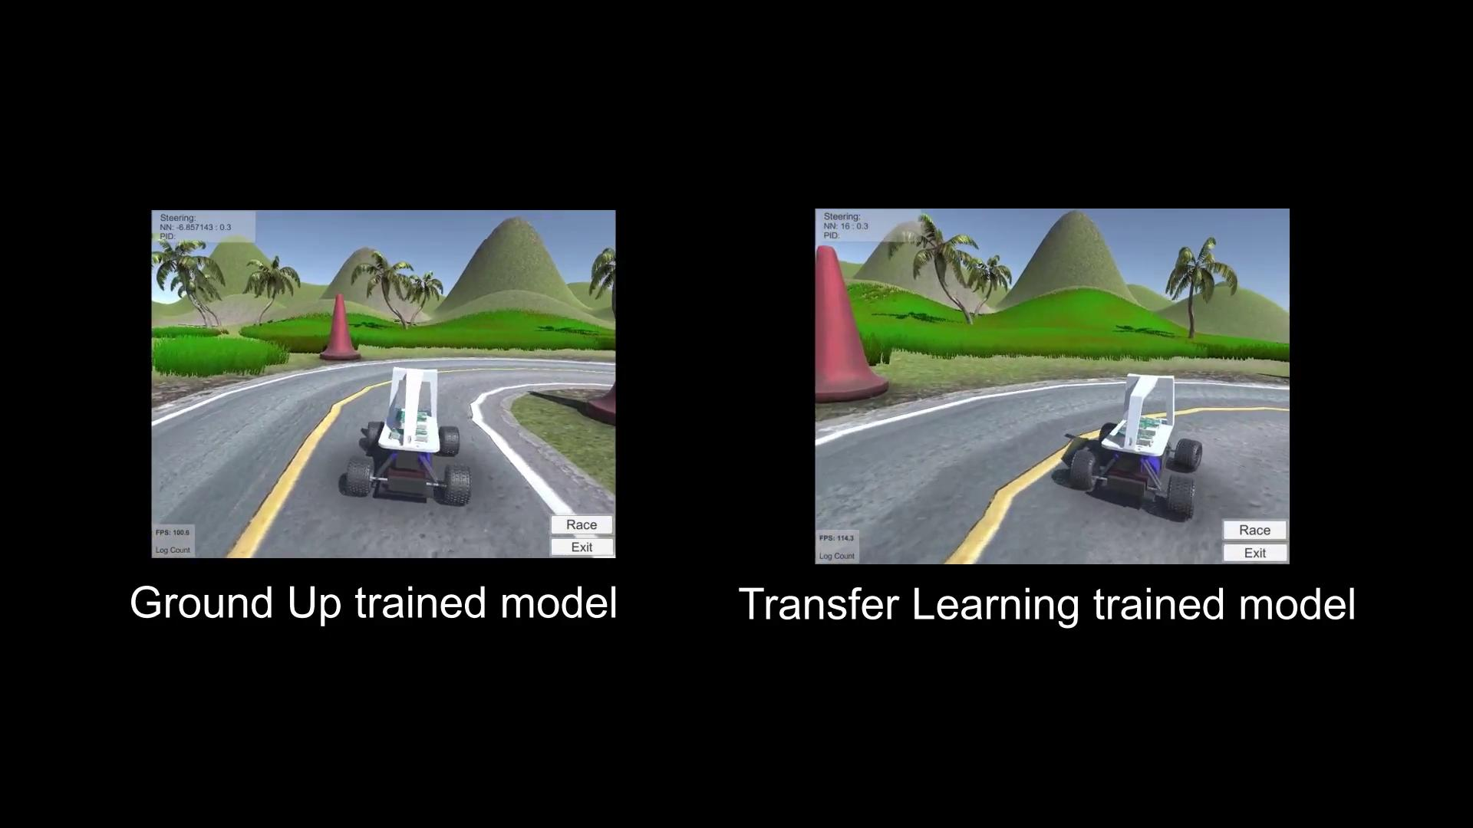
Results - Increased Stability

Slide 16
Time-Line
18/Feb
3/March
17/March
14/April
21/April
Completed!
TORCS RL complete
Donkey car and Udacity car sim RL complete
EDD ready
Transfer between environments
Build generalized image input architecture
Implement PPO TORCS and obtain learning curves
Implement PPO for Donkey car and Udacity car sim
Complete the Engineering Design Document
Develop a plug-and-play model for learning with image input
Compare Transfer Learning and “from-scratch” approach’s performance

Slide 17
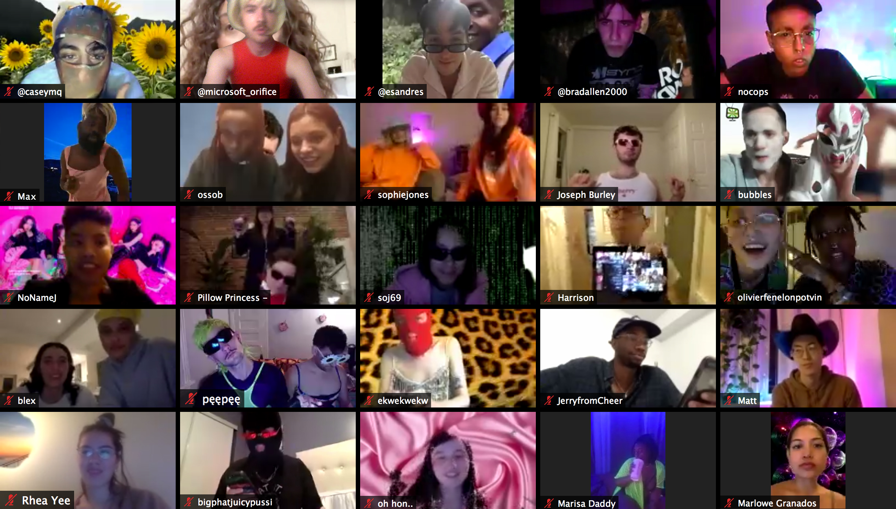
What Next?
ZOOM PARTY!!!

Slide 18
Thank you

